Slide 1

Backtracking
Introduction to Backtracking

Slide 2
Backtracking
Suppose you have to make a series of decisions, among various choices, where
  You don’t have enough information to know what to choose
  Each decision leads to a new set of choices
  Some sequence of choices (possibly more than one) may be a solution to your problem
Backtracking is a methodical way of trying out various sequences of decisions, until you find one that “works”

Slide 3
Backtracking
Backtracking is a technique used to solve problems with a large search space, by systematically trying and eliminating possibilities.
A standard example of backtracking would be going through a maze.
  At some point in a maze, you might have two options of which direction to go:

Slide 4
Backtracking is used to solve problems in which a sequence of objects is chosen from a specified set so that the sequence satisfies some criterion.
Backtracking is a modified depth-first search of a tree.
Backtracking involves only a tree search.
Backtracking is the procedure whereby, after determining that a node can lead to nothing but dead nodes, we go back (“backtrack”) to the node’s parent and proceed with the search on the next child.

Slide 5



Junction

Slide 6
Backtracking
One strategy would be to try going through Portion A of the maze.
  If you get stuck before you find your way out, then you "backtrack" to the junction.
At this point in time you know that Portion A will NOT lead you out of the maze,
  so you then start searching in Portion B
Junction
Portion B
Portion A

Slide 7

Backtracking
Clearly, at a single junction you could have even more than 2 choices.
The backtracking strategy says to try each choice, one after the other,
  if you ever get stuck, "backtrack" to the junction and try the next choice.
  If you try all choices and never found a way out, then there IS no solution to the maze.
Junction
C
B
A

Slide 8
Backtracking (animation)
dead end
?
dead end
dead end
?
start
?
?
dead end
dead end
?
success!

Slide 9
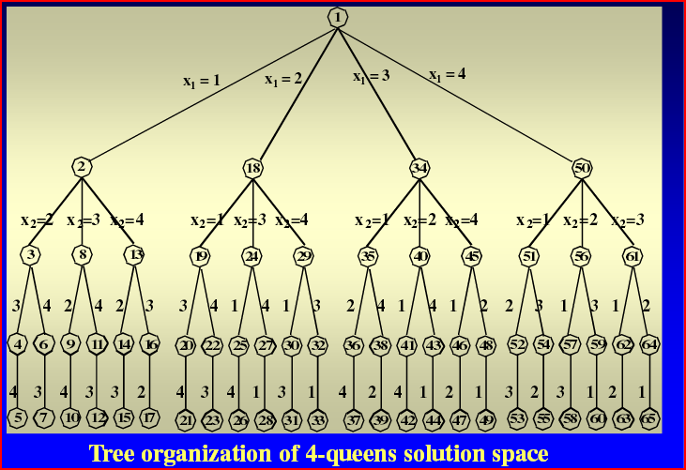
BACKTRACKING PROBLEM

Slide 10
Live nodes
Dead nodes

Slide 11
4 queen’s problem
Consider the chess board of order n*n.The problem is to place n queens on this board such that
No two queens can be place in same row,coloumn,diagonal
i.e no two queens can attack each other.

Slide 12

Backtracking – Eight Queens Problem
The backtracking strategy is as follows:
  Place a queen on the first available square in row 1.
  Move onto the next row, placing a queen on the first available square there (that doesn't conflict with the previously placed queens).
  Continue in this fashion until either:
    you have solved the problem, or
    you get stuck.
      When you get stuck, remove the queens that got you there, until you get to a row where there is another valid square to try.
Q
Q
Q
Q
Q
Q
Continue…

Slide 13
n-Queens problem
If we imagine the squares of the chess board being numbered as indices of two dimensional array A[1..n, 1..n], then for every element on same diagonal running from upper left to lower right, each element has same“row-column” value.
Similarly every element on the same diagonal running from upper right to lower left has the same“row+column”
value. Suppose that two queens are placed at (i, j) and (k, l)
positions.

Slide 14
Algorithm place(k,i)
{
for(j=1 to k-1) do
if(x[j]==i) or abs(x[j]-i)=abs(j-k)
then return false;
return true;
}

Slide 15
They are on the same diagonal iff
i - j = k – l or
i + j = k + l or
j - l = i – k or
j - l = k - i

Slide 16
Algorithm Nqueen(k,n)
{for i=1 to n do
{if place(k,i)then
{ x[k]=i;
if(k=n)then write(x[1:n]);
else Nqueens(k+1,n)
}
}}

